Slide 1

GUITAR TUNER APP Tune your guitar perfectly with just the built-in microphone of your Android smartphone. Supports various detection algorithms and noise cancellation
by Sukhan Eric

Slide 2

01.
Актуальність проєкту

Slide 3

Problem statement and reasoning
Objective: To develop software for automating the tuning of stringed instruments using digital signal processing methods, which ensures high accuracy, interactivity and adaptability to user needs.
Reasons: automation of the tuning process, integration of sound detection algorithms, customisation of tunings.

Slide 4

TECHNOLOGIES USED
TarsosDSP
Jetpack Compose & Material 3
Digital audio signal processing
Reactive interface and modern design
MIDI / C++ NDK
Room DB
Software-based note generation
Database, storage of frequencies and guitar presets
Kotlin Flows & Coroutines
Koin, DI, Gradle
Multithreading and asynchronous
Dependency and build management

Slide 5
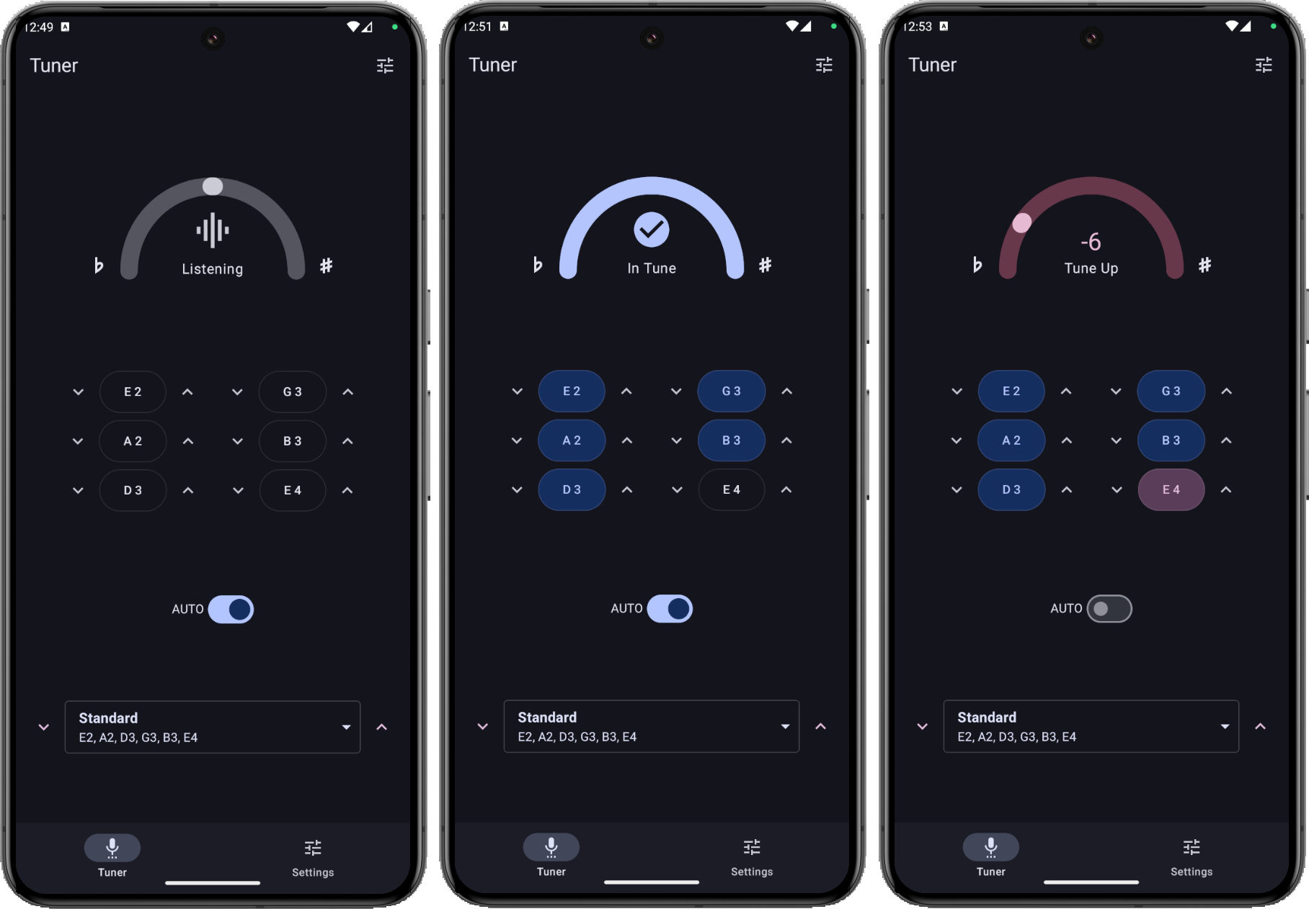
Tuner screen (dark)

Slide 6
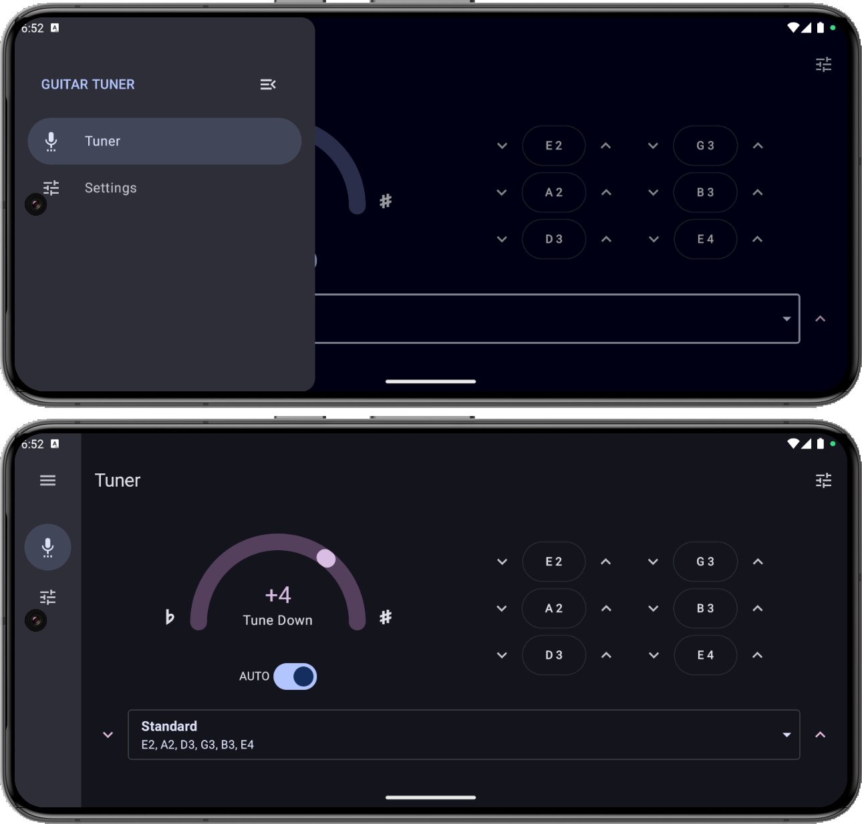
Tuner screen (horizontal orientation)

Slide 7
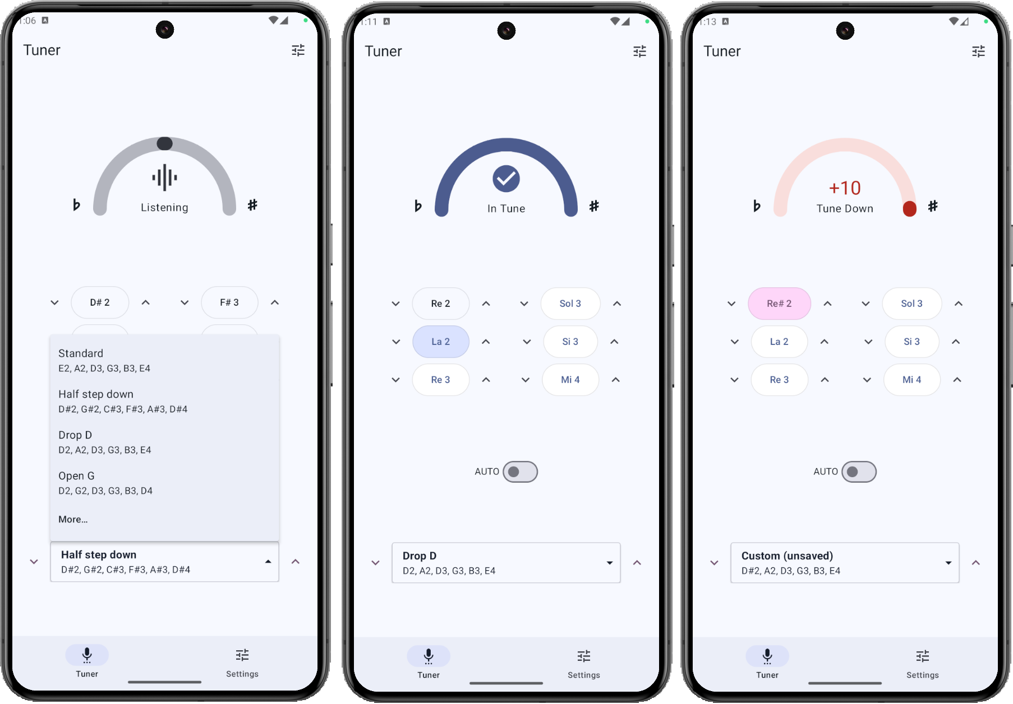
Tuner screen (light)

Slide 8
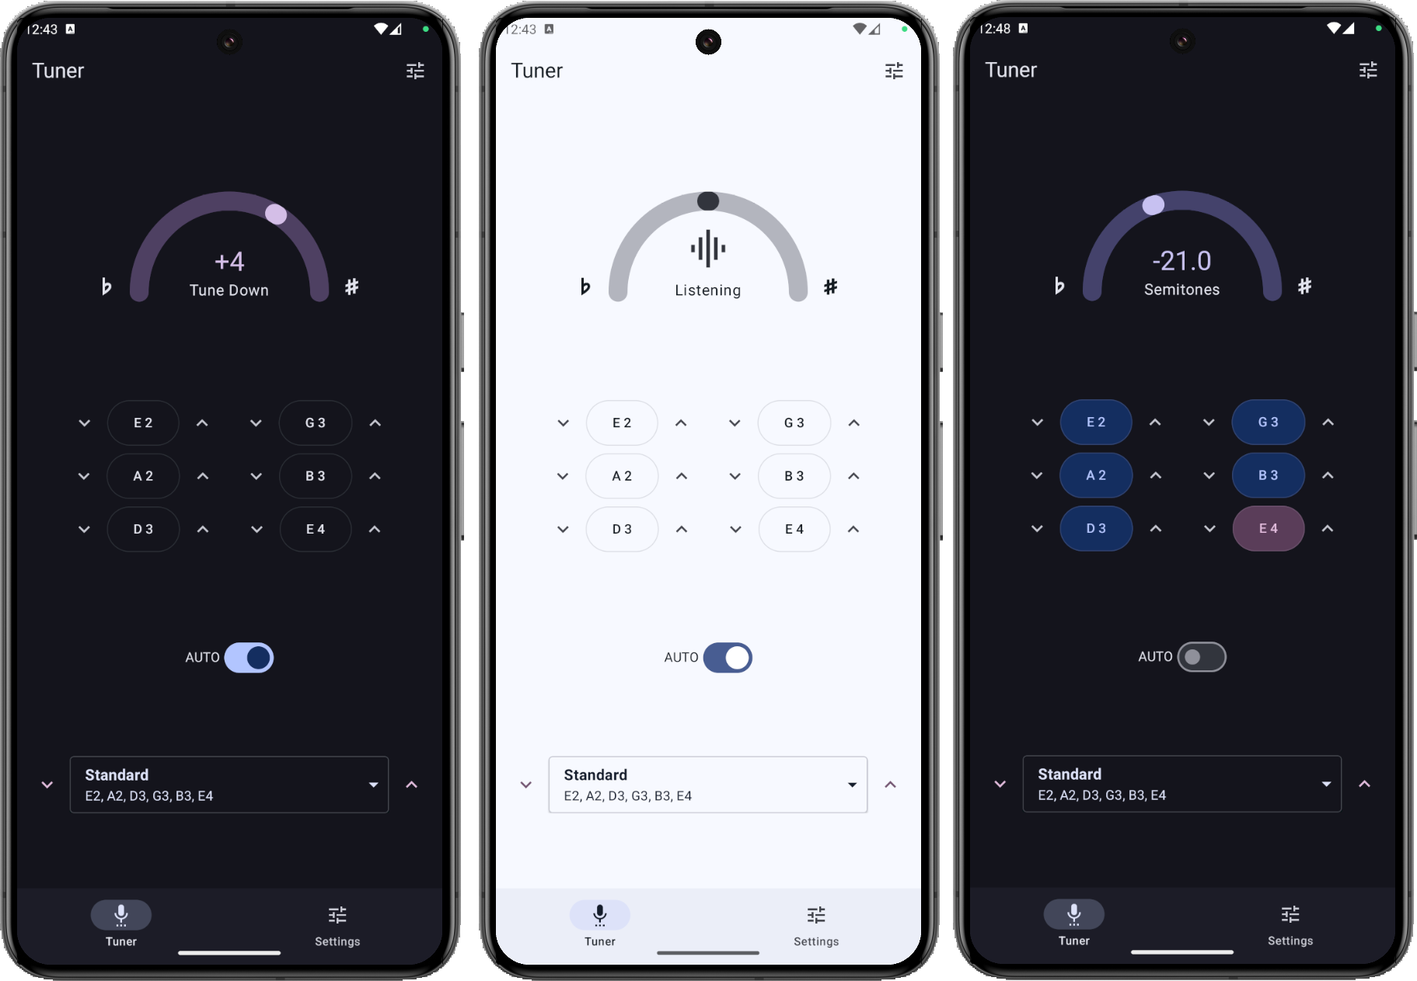
Tuner screen

Slide 9
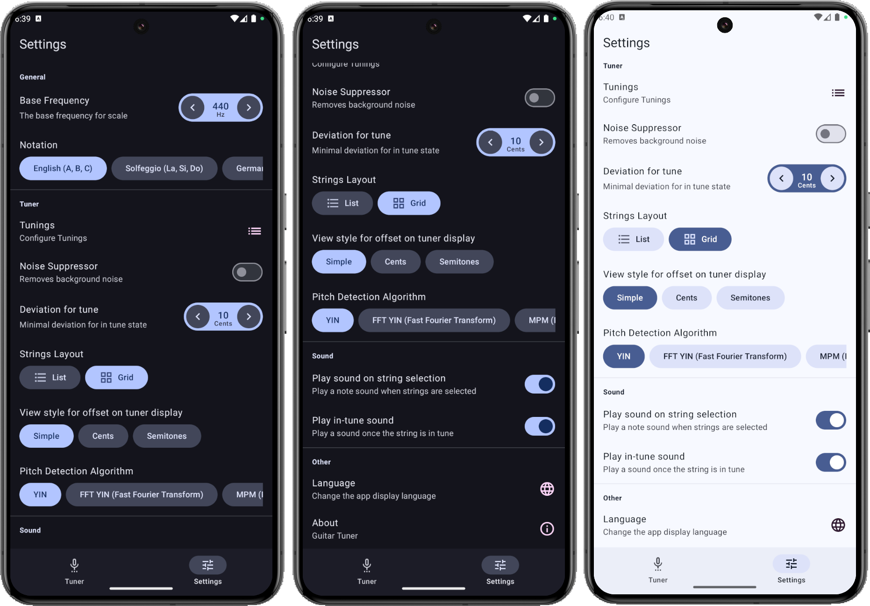
Settings screen

Slide 10
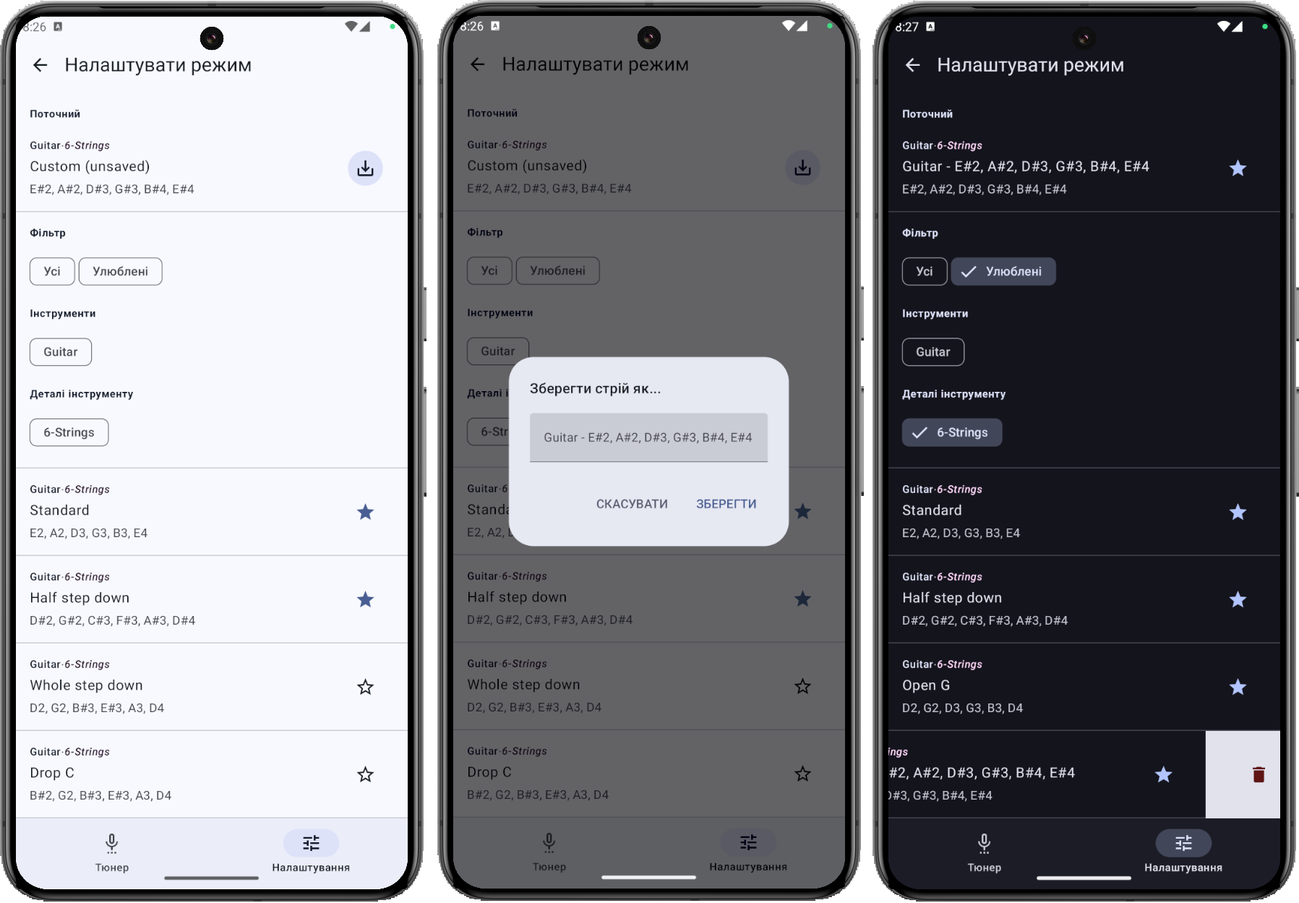
Instrument tuning sets screen

Slide 11
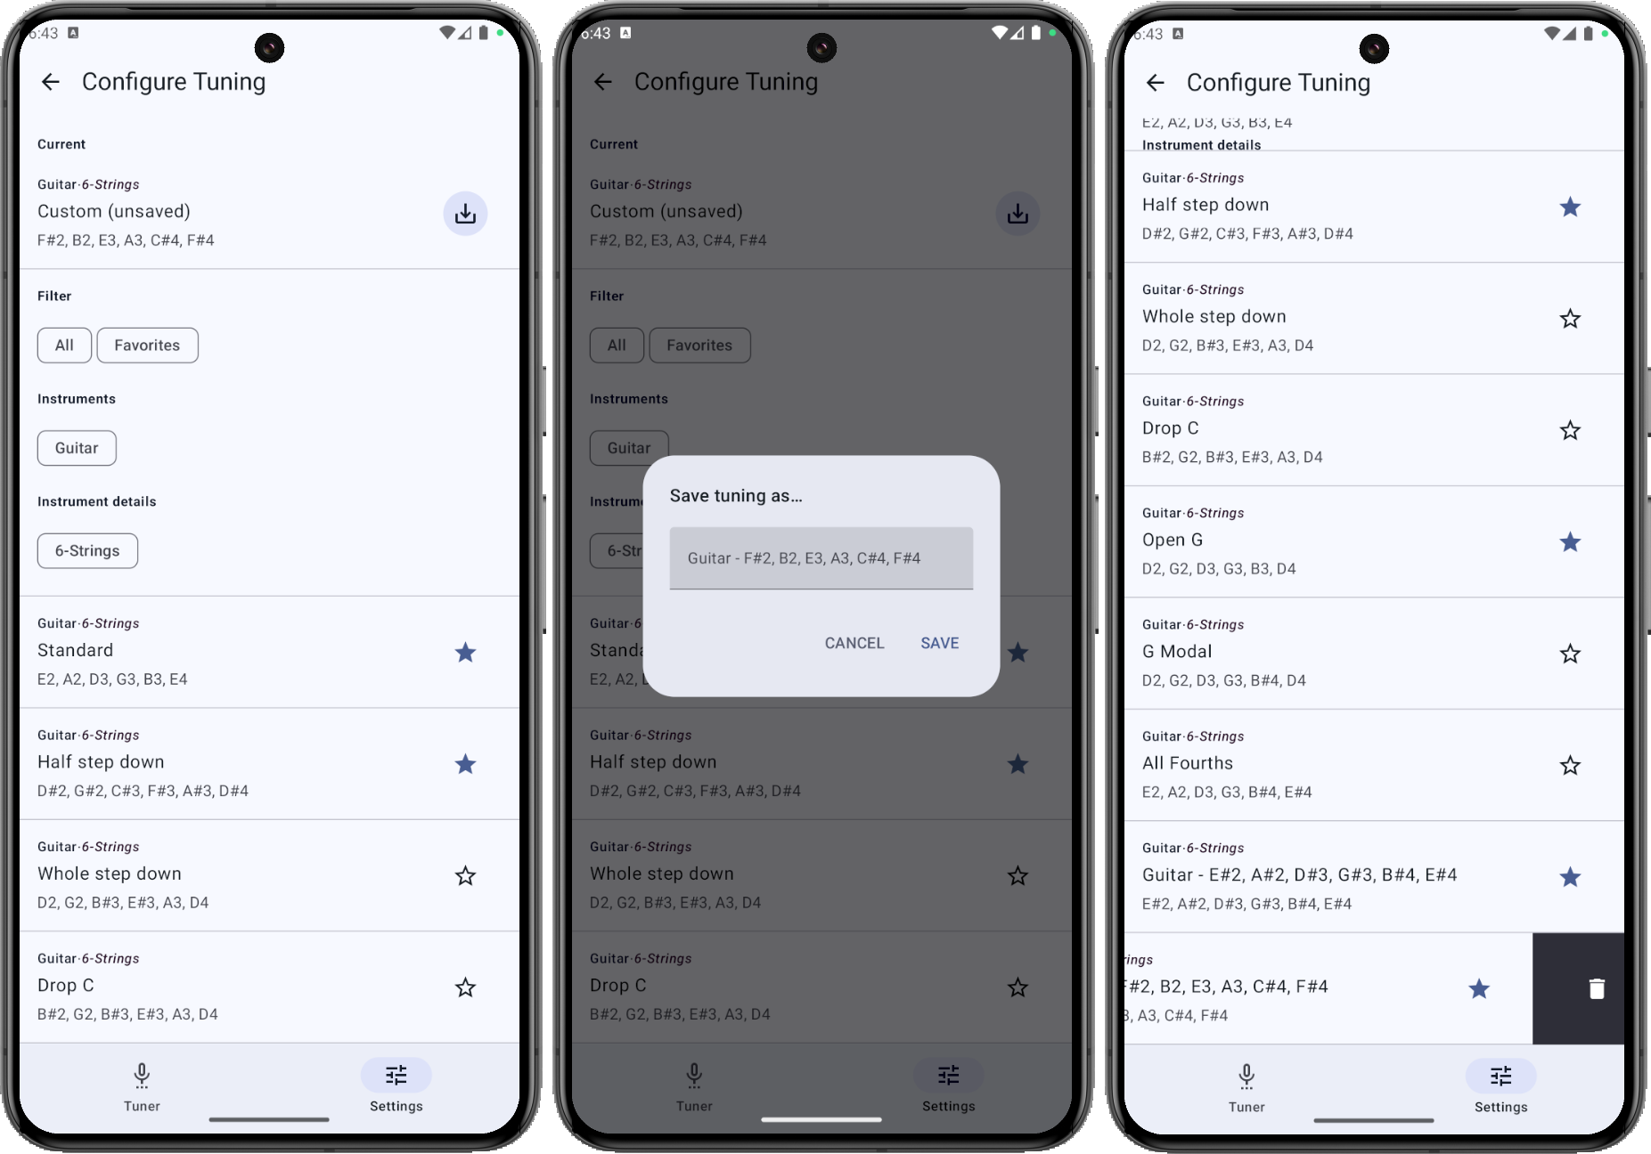
Instrument tuning sets screen (light)

Slide 12
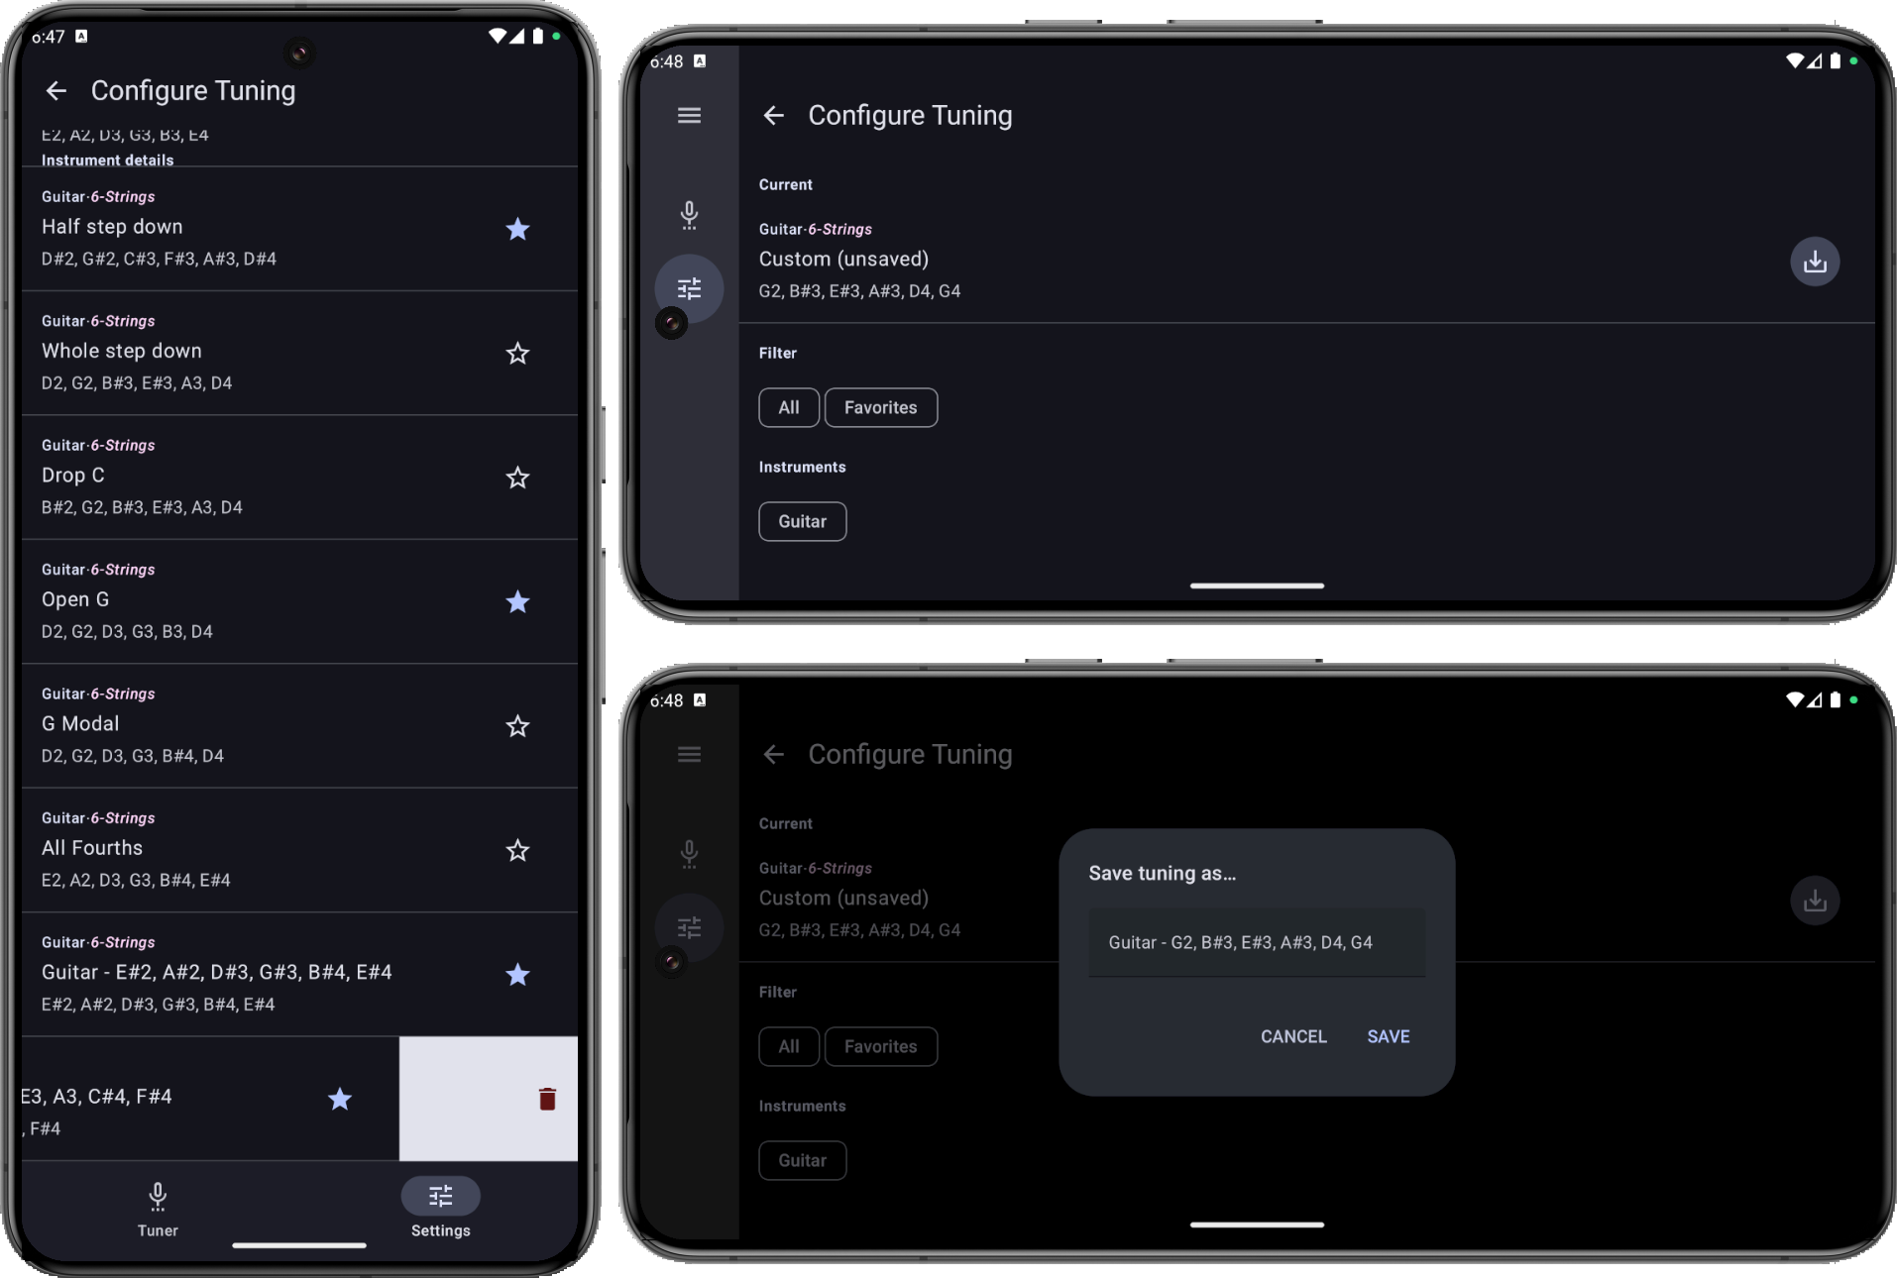
Instrument tuning sets screen (dark)

Slide 13
ARCHITECTURE
Presenter
UI
Event
Update
VIEW
Domain
MODEL
View
Model
Binding
Notify
Repository
Data source

Slide 14
Implemented frequency detection algorithms
Algorithm | Implementation Features | Computational Cost | Execution Speed | Noise Sensitivity | Accuracy
YIN | Autocorrelation analysis of the signal | Medium | Medium | Low | High
FFT YIN | Fast Fourier Transform | High | High | Medium | High
MPM | Optimized for real-time processing | Low | High | Medium | High
AMDF | Simple computational method | Low | High | Low | Medium
DYWA | Uses wavelet analysis | Medium | High | High | High

Slide 15
SUMMARY
1
2
3
4
5
Developed a software tuner for musical instruments
A multi-level architecture was employed to divide responsibilities
Integrated advanced and modern sound processing algorithms
Customization of instrument tuning sets has been provided
Created an intuitive, user-friendly, responsive interface

Slide 16
THANKS!
www.linkedin.com/in/erik-sukhan/

